Slide 1
Null Hypothesis Significance Testing
Additions to Linear Models

Slide 2
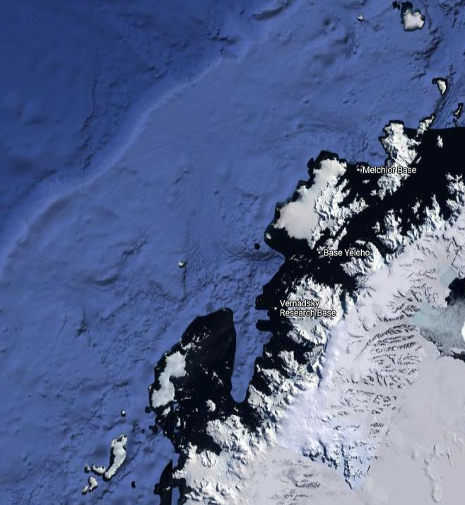
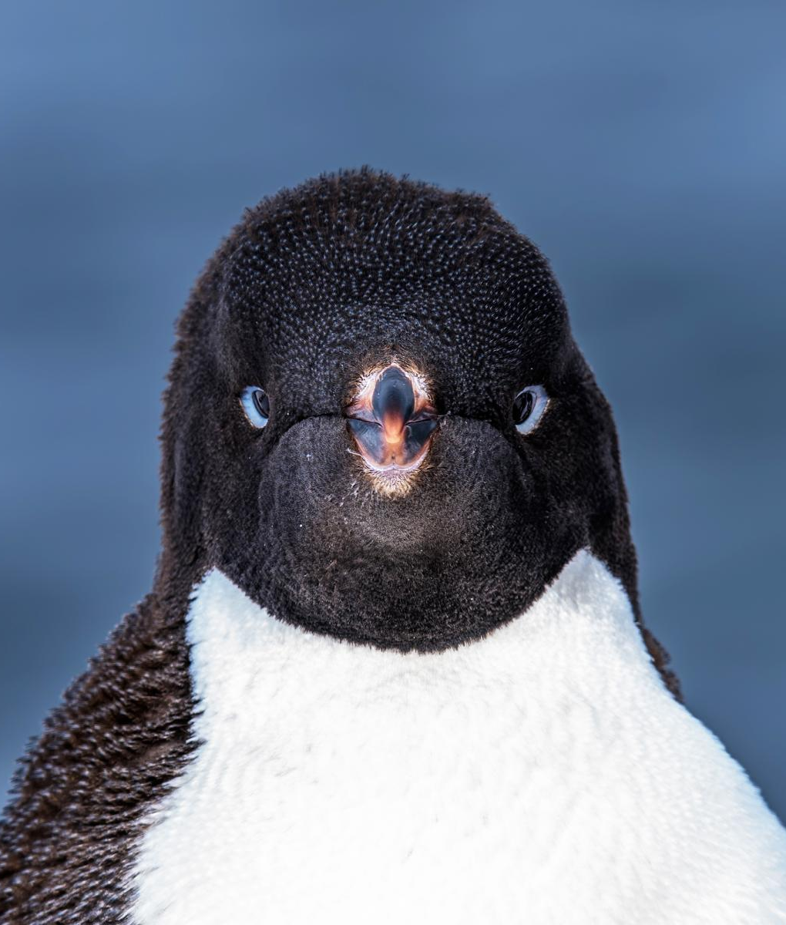
Question
Adelie penguins
Diet varies according to what’s available (krill, laternfish, etc)
Data from three islands
Biscoe, Dream and Torgersen
Does Adélie penguin weight differ between the three islands?

Slide 3
Question
Does Adélie penguin weight differ between the three islands?
Under NHST, we rephrase our question to a hypothesis (or statement) that we attempt to reject
“There is no difference in Adélie size between the three islands”
We now set out to disprove this

Slide 4
The Popperian philosophy

Slide 5

Why so negative?
NHST closely follows a philosophy of science described by Karl Popper
Many other scientific philosophies
(Some are much better)
Popper sought to distinguish between “science” and “pseudo-science”
Crudely, they argued that “science” tries to prove itself wrong, while “pseudo-science” tries to prove itself right

Slide 6

Why so negative?
If we cannot prove that we are wrong, then we assume we are right
Rather than trying to prove that reiki does something, we try to show it does nothing
While keeping in mind that new data might come along that could change our mind
When people refer to the “scientific method”, they are generally subscribing to Popper’s philosophy (normally unknowingly)

Slide 7

Null hypotheses
“Rather than trying to prove that reiki does something, we try to show it does nothing”
“Does nothing” is the Null hypothesis $(H_{O})$
Or “no difference”
“Does something” is the Alternative hypothesis $(H_{A})$
Or “difference”
Note: you still use hypotheses even if not using NHST

Slide 8
P-values

Slide 9
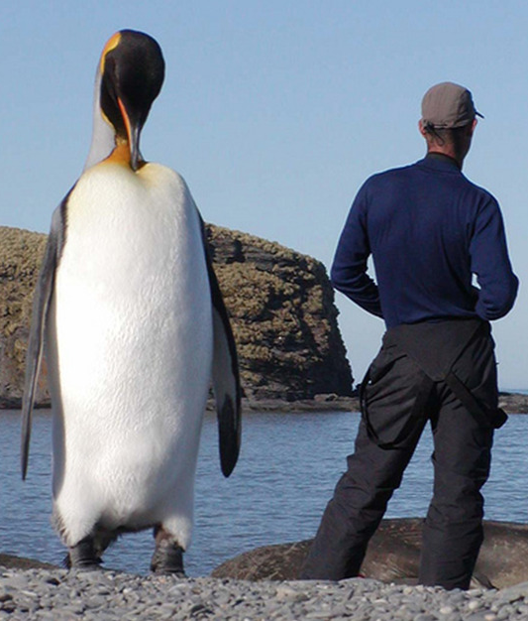
P-values
Crudely:
What is the probability that the thing you just observed could have happened just by pure chance?
I.e. How likely is it that there is “no difference”, given there is variation?
E.g. how likely is it to see a 1.56 m tall Emperor penguin, given the average is 1.1 m?

Slide 10
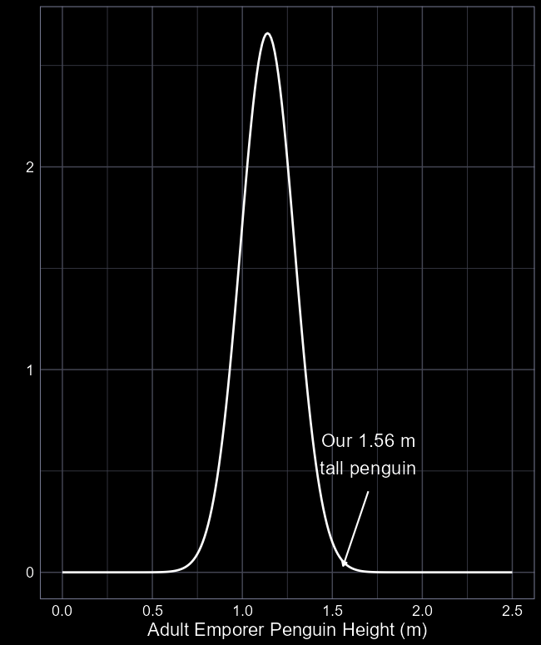
Just by chance?
It’s not impossible that we would observe a 1.56 m tall penguin
But doesn’t seem very likely
What’s the probability of seeing a very big or very small penguin?

Slide 11
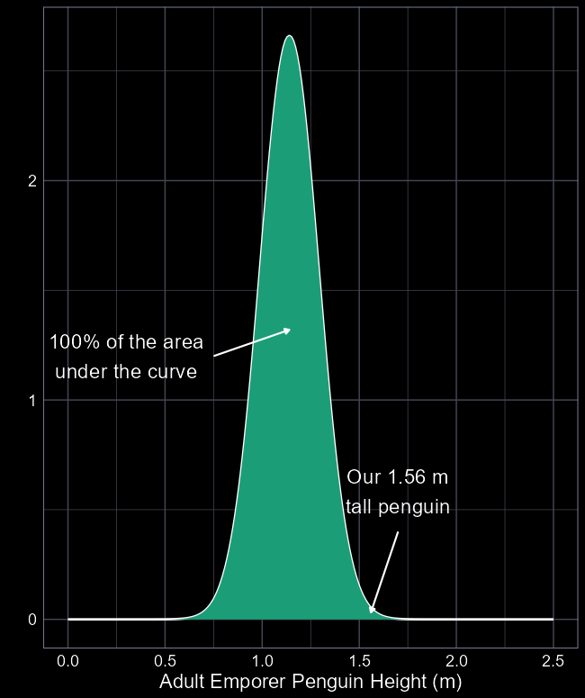
Just by chance?
The green area captures all possible heights we could measure of Emperor penguins
Given the average height of 1.1 m
And a standard deviation of 15 cm
Area under the curve includes our 1.56 m tall penguin

Slide 12
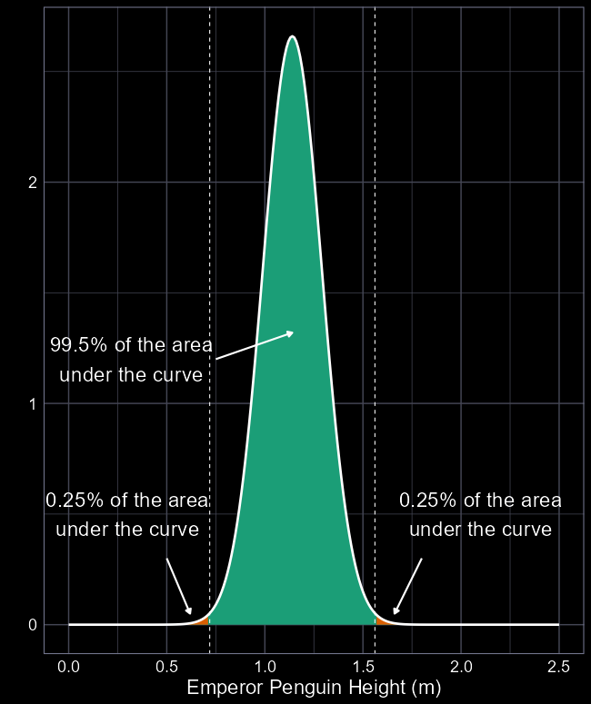
Just by chance?
99.5% of penguins between 0.71 m and 1.56 m tall
So, a 99.5% probability that if we measured a penguin, they’d be within that range
0.25% of penguins are greater than or equal to 1.56 m tall
So, a 0.25% probability that each time we measure a penguin, it will be greater than 1.56 cm tall

Slide 13
Two possible explanations
Either this 1.56 m tall penguin came from the same distribution
It’s just very rare to see one this big
Or it came from some other unknown distribution (e.g. orange)
E.g. a population with particularly tall penguins
P-values tell us what the probability is that it came from the white distribution

Slide 14


Just by chance?
The P-value to see an extreme height, like our giant 1.56 m tall penguin, is:
Probability of being $≥$ 1.56 m
Probability of being very small ($≤$ 0.71 m)
Included as we want to know extremes
$P=0.0025+0.0025=0.005=0.5\%$
A “two-sided” or “two-tailed” P-value
0.5% chance our 1.56 m penguin came from the same distribution as our “normal” penguins

Slide 15
“Statistical significance”

Slide 16
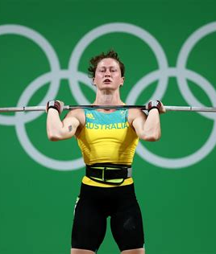



$α$ level
Getting a P-value does not quite get us to NHST
For that, we need some threshold for a probability which we deem to be meaningful
Choice is entirely arbitrary
But researchers tend to fixate (incorrectly) on a threshold of 5%
I.e. there is less than a 5% chance that the 1.56 m tall penguin came from the same distribution
$$α$$
$$α$$

Slide 17

$α$ level
If the P-value is below $α$, then we reject our Null hypothesis
Remember, our Null hypothesis is “no difference” (to white distribution)
For our tall penguin, our Null hypothesis is:
The 1.56m tall penguin is part of the white distribution
If the P-value is above $α$ (i.e. big), then we accept this statement
If the P-value is below $α$ (i.e. small), then we reject this statement
$$α$$
$$α$$

Slide 18



$$α=0.05$$
To be very, very clear
Putting the threshold at 5% (or P $≤$ 0.05) is completely arbitrary
There is zero (!) statistical rationale for this
Could be as dumb as we have 5 fingers on one hand, so let’s set $α$ to 5%
The person who developed this method even warned that 5% should not be thought of as being meaningful
Yet people still use $α=0.05$ blindly
5%

Slide 19


The magic words
“Statistical significance”
When we have a P-value that is less than 0.05 (the usual $α$ threshold) we can say “statistically significant”
For our tall penguin, they are statistically significantly unlikely to come from the same distribution
Given P = 0.005, there’s only a 0.5% chance that it does come from the same distribution as it’s friends :(

Slide 20
NHST in statistical models

Slide 21
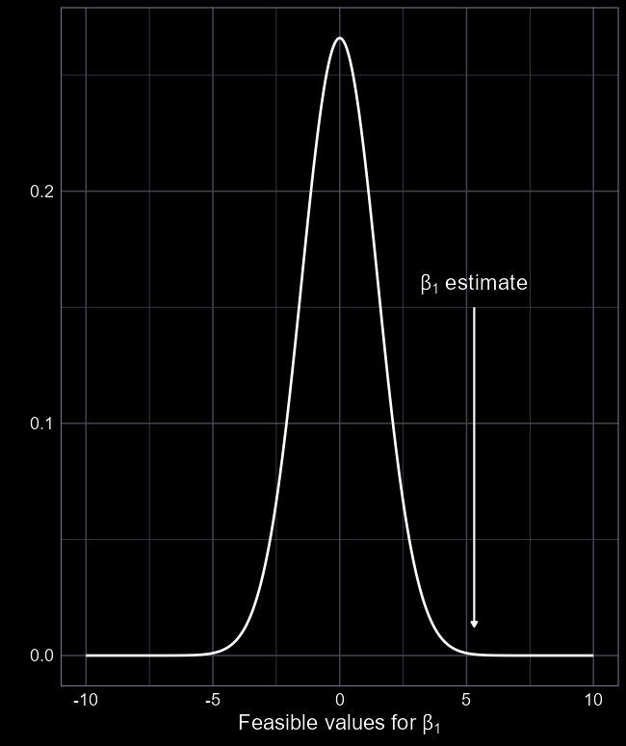
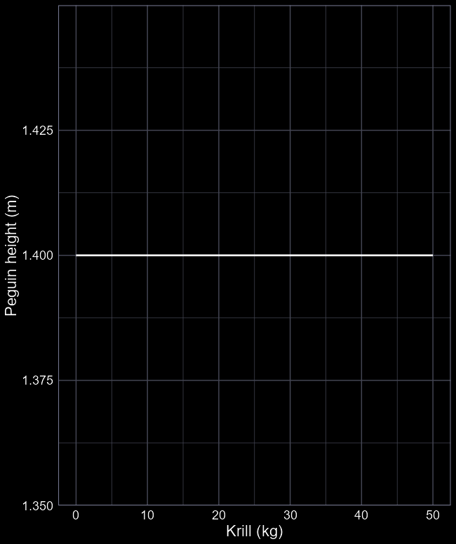



Null hypotheses
Within statistical models, we translate the Null hypothesis into:
“What is the probability my parameter comes from a distribution with a mean of zero?”
$β_{1}=0$?
Why $β_{1}=0$?
If a parameter is estimated as 0, then there is no association
E.g. a slope that is 0
I.e. our Null hypothesis
$$β_{1}=0$$
$$β_{0}=1.4$$

Slide 22

A problem
We don’t know what the distribution for $β_{1}=0$ is. We just know the mean is 0.
We don’t have a way to figure out the standard deviation.
We need a different way to calculate our P-value

Slide 23
Adélie penguins and NHST

Slide 24
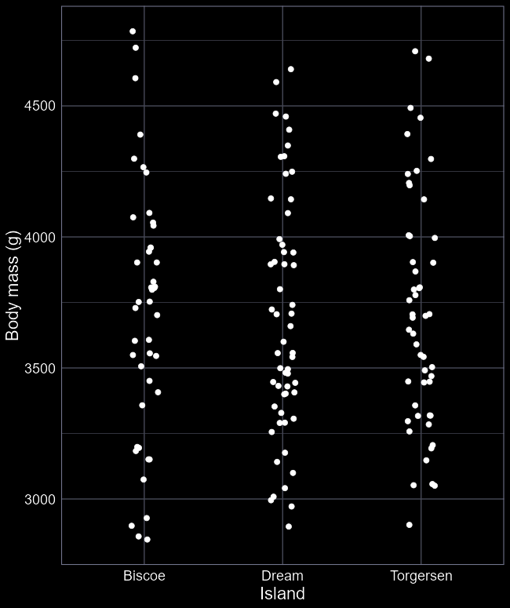
Adélie penguin data
We’ll use NHST to help us answer our question if Adélie body size is different on the three islands
Start by doing some EDA
What model would we run to test our question?
lm(body ~ island)

Slide 25
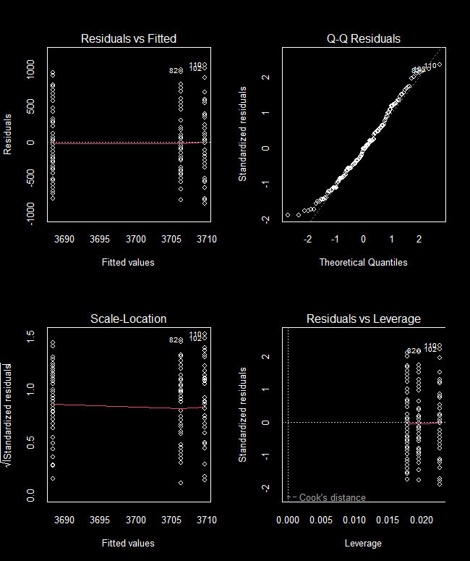
Diagnose
As always, quickly check the diagnostic plots
Any issues?

Slide 26

summary(peng_mod)
Call:
lm(formula = body ~ island, data = df)
Coefficients:
Estimate Std. Error t value
(Intercept) 3709.659 69.582 53.314
islandDream -21.266 92.983 -0.229
islandTorgersen -3.287 94.967 -0.035
To get our P-values we need:
Estimate
Std. Error
If we divide Estimate by Std. Error, we get the t value
$t= \frac{Estimate}{Std. Error}$
With this t value, we can switch from assuming a $Normal$ distribution to a $T$ distribution

Slide 27
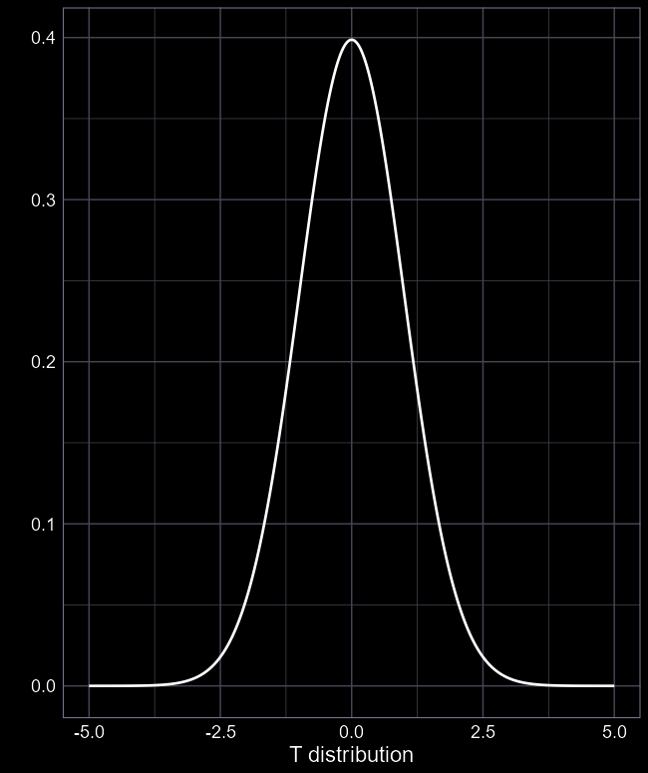


The $T$ distribution
The $T$ distribution needs just one parameter; degrees of freedom ($df$)
$df=n−p−1$
(We don’t need $σ$ like in the $Normal$)
Where:
$n$ is our sample size (344 penguins)
$p$ is the number of parameters (3)
Giving $T(df=340)$
This allows us to create a distribution to test if our parameters are different to 0
https://deonroos.shinyapps.io/Distributions/

Slide 28
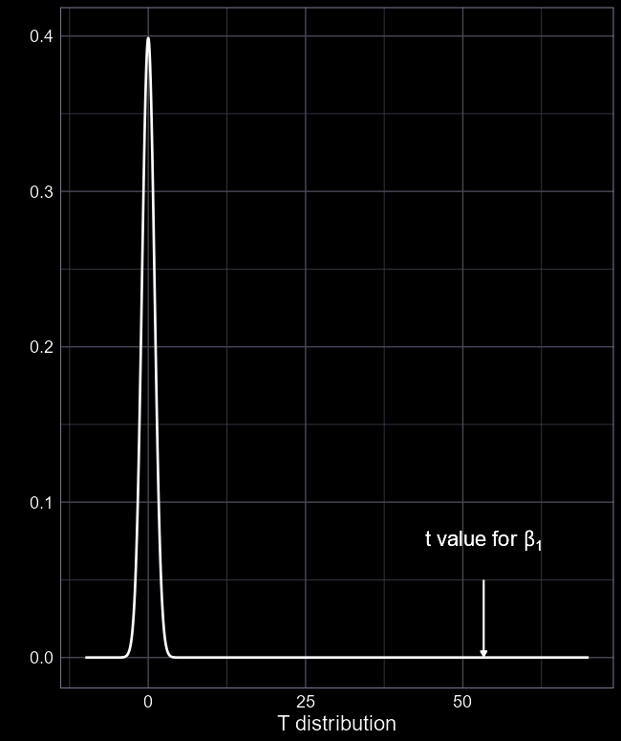
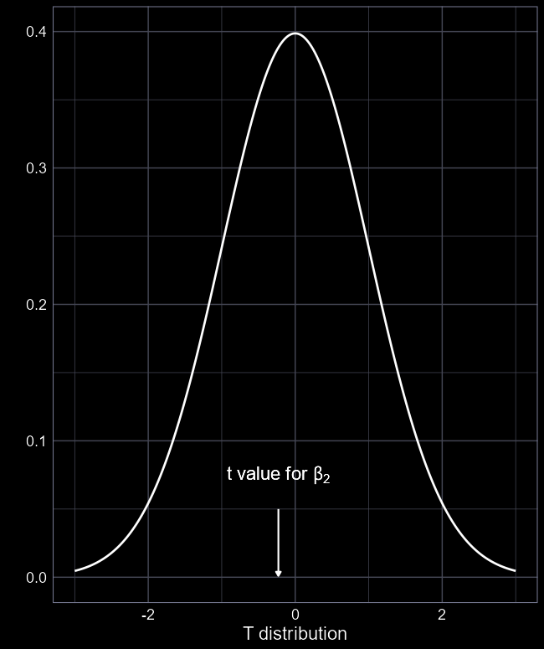
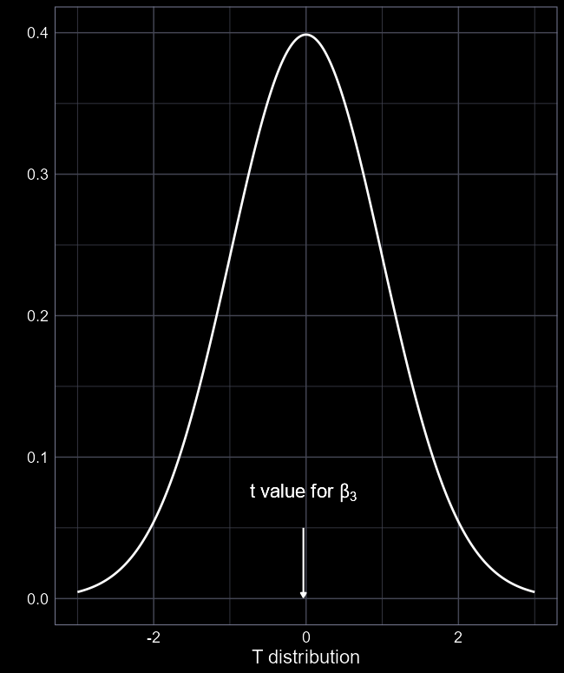
Are these significant?
Call:
lm(formula = body ~ island, data = df)
Coefficients:
Estimate Std. Error t value Pr(>|t|)
(Intercept) 3709.659 69.582 53.314 <2e-16
islandDream -21.266 92.983 -0.229 0.819
islandTorgersen -3.287 94.967 -0.035 0.972
Note that <2e-16 is scientific notation for <0.0000000000000002

Slide 29
Significant what?
Call:
lm(formula = body ~ island, data = df)
Coefficients:
Estimate Std. Error t value Pr(>|t|)
(Intercept) 3709.659 69.582 53.314 <2e-16
islandDream -21.266 92.983 -0.229 0.819
islandTorgersen -3.287 94.967 -0.035 0.972
An easy way to think of what P-values mean in statistical models is:
“Is the Estimate different to 0?”
Our (Intercept) is 3709.659, so clearly different to 0
Dream penguins are -21.266 g smaller than Biscoe penguins
But 82% chance the difference with Biscoe is 0
Torgersen penguins are -3.287 g smaller than Biscoe penguins
But 97% chance the difference with Biscoe is 0

Slide 30
Strawman argument
Call:
lm(formula = body ~ island, data = df)
Coefficients:
Estimate Std. Error t value Pr(>|t|)
(Intercept) 3709.659 69.582 53.314 <2e-16
islandDream -21.266 92.983 -0.229 0.819
islandTorgersen -3.287 94.967 -0.035 0.972
Do you think penguins could ever weigh 0 g?
Definitely not.
Even though it’s significant, we’d never seriously think it was going to be 0
So here, we find no significant difference in penguin weight across the three islands

Slide 31
Criticisms of NHST

Slide 32
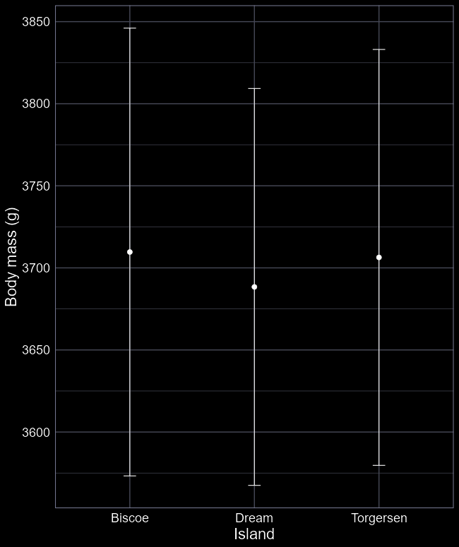
Need for NHST?
Call:
lm(formula = body ~ island, data = df)
Coefficients:
Estimate Std. Error t value Pr(>|t|)
(Intercept) 3709.659 69.582 53.314 <2e-16
islandDream -21.266 92.983 -0.229 0.819
islandTorgersen -3.287 94.967 -0.035 0.972
Did you really need P-values to tell you that the penguins on the islands were pretty much the same?
You can often reach the same conclusion just looking at the Estimate and Standard Error (or 95% CI) without needing P-values
Or just plotting the results

Slide 33
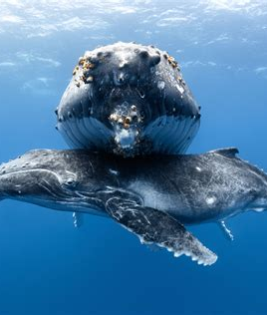
Biological significance
Statistical significance is not the same as biological significance
A parameter might be very very weak but be different from zero
For example
“Ecotourism boats had a significantly negative effect on juvenile humpback whale growth”
Decreased growth rate by 7 cm per year
Adults reach 14-17 m…

Slide 34
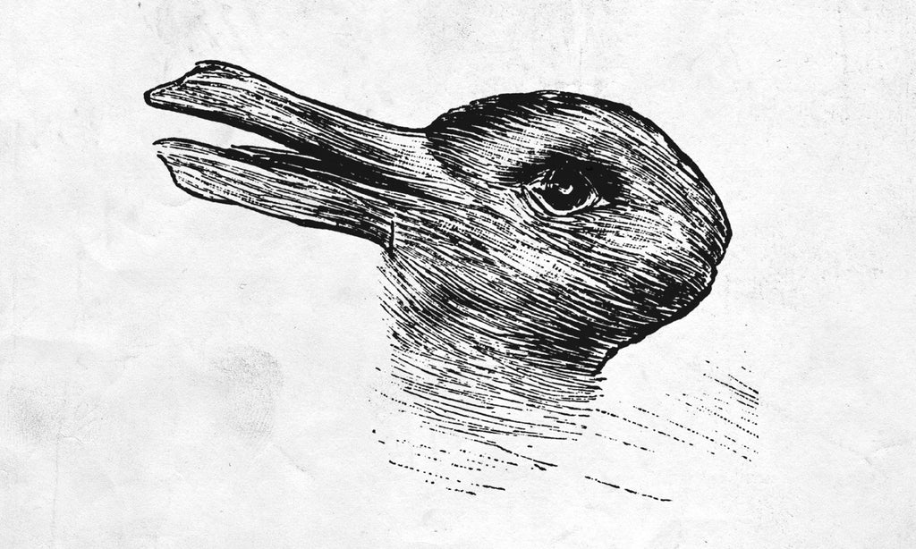
Ambiguous
What can you tell me based on the following statement?
“The treatment had a significant effect”
Is this positive or negative?
Significance just says it’s “not zero”
“The treatment didn’t not do something”
No idea if it makes things better or worse
Big or small?
Keep in mind, you can get trivially small Estimates that are significant

Slide 35
5% is still pretty high
5% chance to have generalised anxiety
3% chance to get 5 head coin flips in a row
8% chance to be accepted by Edinburgh Uni
Just because people use 5% as a threshold, does not mean it makes any sense
5%

Slide 36
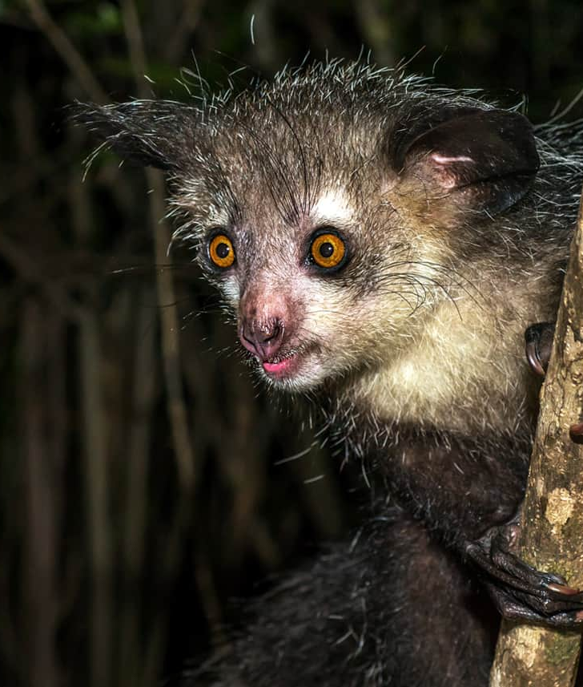
Additional oddities
The bigger your sample size, the more likely you are to have a significant difference
You can get “false positives” (type 1 error) – significant P-values when there is no difference
Doing multiple tests increases the chance of getting false positives (and negatives)
P-values are highly sensitive to confounded relationships

Slide 37

tl;dr
A P-value quantifies the probability that a value is likely to come from a reference distribution
For the tall penguin, the reference distribution was a $Normal$ distribution with the mean and standard deviation of penguin heights
For parameters in a linear model, the reference distribution is a $T$ distribution
See here for more on the $T$ distribution https://deonroos.shinyapps.io/Distributions/
We deem P-values “statistically significant” if they are below the $α$ threshold
For no logical reason, the $α$ threshold is usually 5% (or 0.05)
NHST is useful but is heavily overused

